Slide 1


Hotel Management DBMS Mini-Project
-Harsh Nagvanshi : 4NM19CS072
-Devansh Shekhar : 4NM19CS057

Slide 2
ABSTRACT
The purpose of Hotel Management System is to automate the existing manual system by the help of computerized equipment and full-fledged computer software, fulfilling their requirements, so that their valuable data/information can be stored for a longer period with easy accessing and manipulation of the same. The required software and hardware are easily available and easy to work with.
Hotel Management System, as described above, can lead to error free, secure, reliable and fast management system. It can assist the user to concentrate on their other activities rather to concentrate on the record keeping. Thus it will help organization in better utilization of resources. The organization can maintain computerized records without redundant entries. That means that one need not be distracted by information that is not relevant, while being able to reach the information.
The aim is to automate its existing manual system by the help of computerized equipment and full-fledged computer software, fulfilling their requirements, so that their valuable data/information can be stored for a longer period with easy accessing and manipulation of the same. Basically the project describes how to manage for good performance and better services for the clients

Slide 3
INTRODUCTION
Hotel Management System is an administrator side hotel management site script where site users will be able to browse rooms, check availability, feed customer and staff’s data and manage reservations in real-time.
The functionality of the site are summarized in the following points:
-Staff – User can manage staff details including the staff ID , Name ,Job he is assigned , salary he is paid for the job and his phone number.
- Room – User can define the room available in the hotel along with the prices.
- Reservations – User can enter the check-in and check-out details of the user along with the customer and room details.
- Customers – User can enter the customer’s details and can access the customer details and the room details of the customer.
- Ratings – User can enter the customers review based on their personal experience.

Slide 4
OBJECTIVE
Hotel Management System, can lead to error free, secure, reliable and fast management system. It can assist the user to concentrate on their other activities rather to concentrate on the record keeping. Thus it will help organization in better utilization of resources. The organization can maintain computerized records without redundant entries. That means that one need not be distracted by information that is not relevant, while being able to reach the information.
The project basically helps user to :-
Enter staff details.
Keep record of the customers.
Check Availability of rooms for customers.
Reservation of rooms.
Maintain record of the types of rooms available in the hotel.
Update the feedback of the customers.

Slide 5
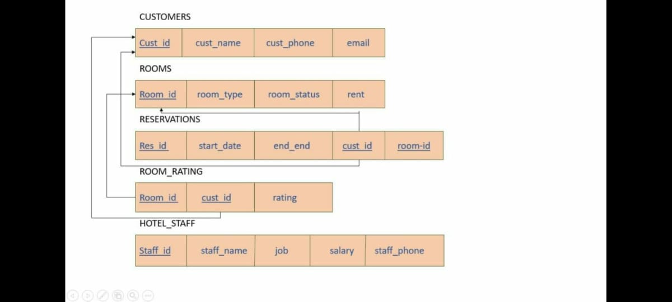
SCHEMA

Slide 6
METHODOLOGY(Waterfall Model)

Slide 7
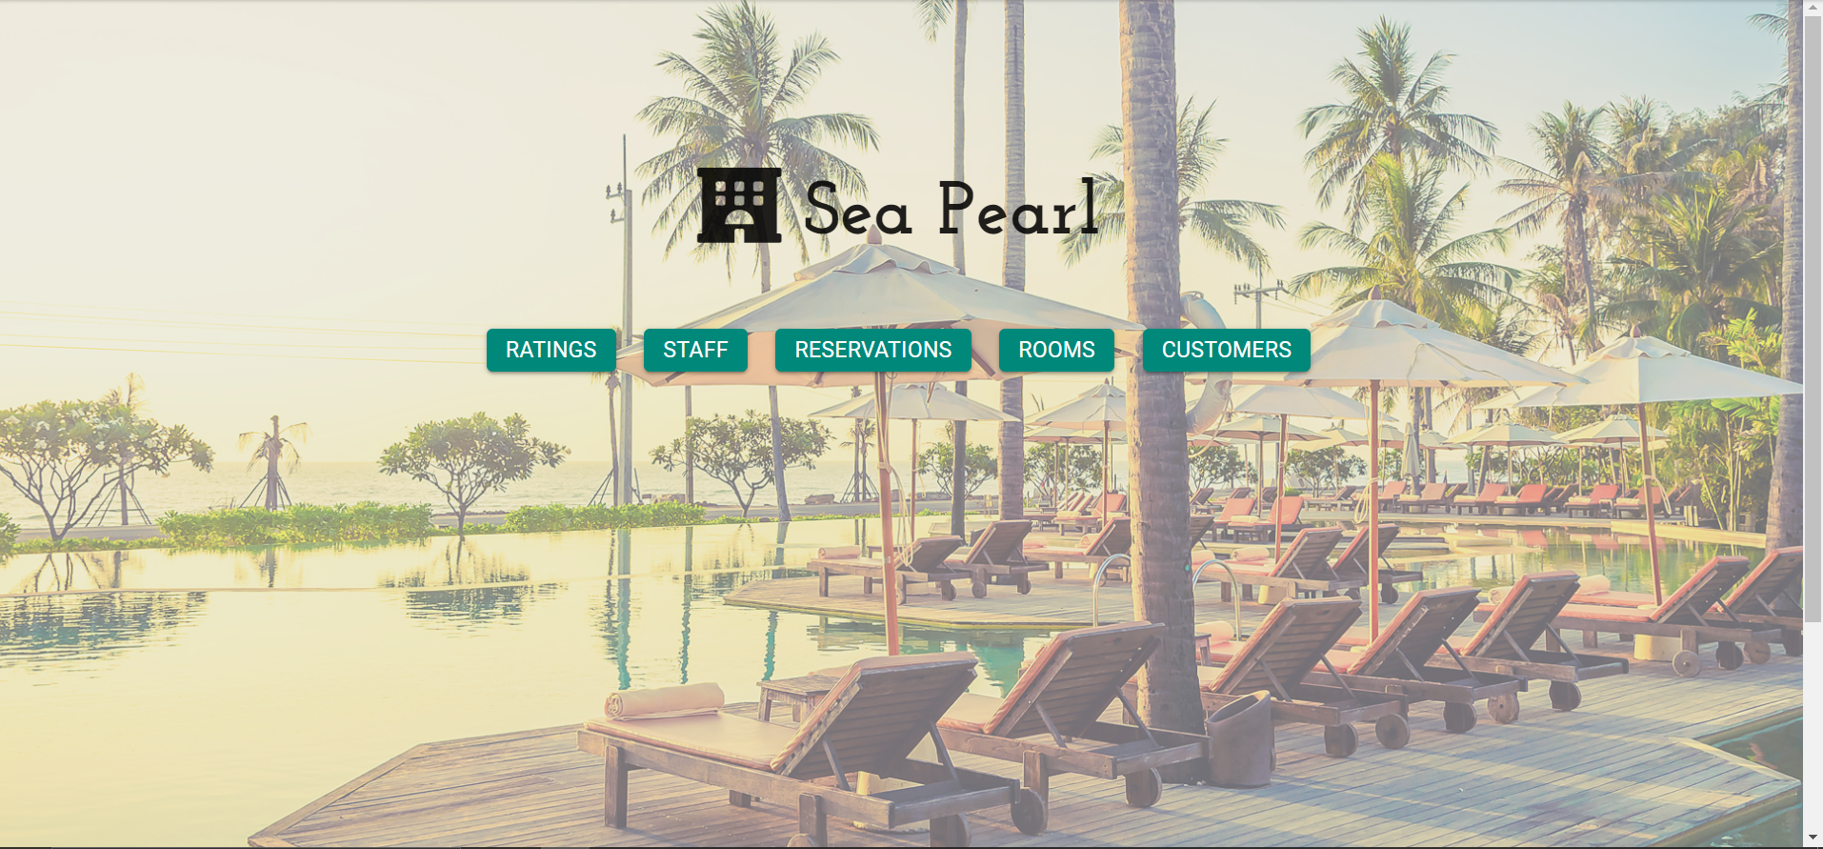
OUTPUT
(Website HomePage)

Slide 8


THANK YOU

